Slide 1
Programming For Problem Solving
UNIT-I
*
1
Notes:
1

Slide 2
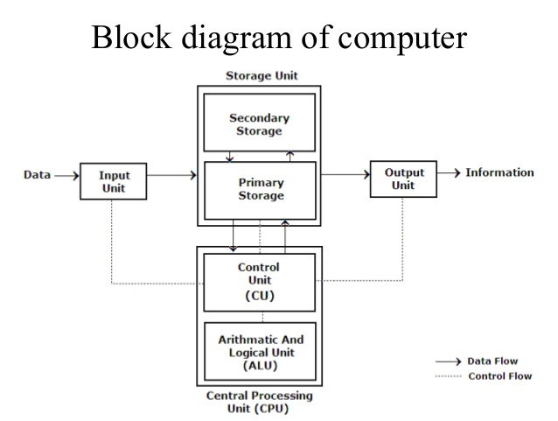
FUNCTIONAL UNITS OF DIGITAL COMPUTER Computer: Computer is an electronics device that can perform various arithmetic and logical operations. It can receive data, process it and produce output. It can store large amount of data.
*
2

Slide 3
FUNCTIONAL UNITS OF DIGITAL COMPUTER
A digital computer is considered to be a calculating device that can perform arithmetic operations at enormous speed.
1. Input Unit: The commonly used input devices are mouse, floppy disk drive, magnetic tape etc. Thus, we can conclude that, all the input devices accepts the data and instruction from outside world, convert it to a form that the computer can understand, supply the converted data to the computer system for further processing.
2. Storage Unit: The storage unit of a computer holds data and instructions that are entered through the input unit, before they are processed. It stores programs, data as well as intermediate results and results for output. Its main function is to store information.
*
3

Slide 4
FUNCTIONAL UNITS OF DIGITAL COMPUTER
Memory can be classified as following:
a. Primary Memory can be further classified as RAM and ROM.
RAM or Random Access Memory is the unit in a computer system. It is the place in a computer where the operating system, application programs and the data in current use are kept temporarily so that they can be accessed by the computer’s processor. It is said to be ‘volatile’ since its contents are accessible only as long as the computer is on. The contents of RAM are no more available once the computer is turned off.
ROM or Read Only Memory is a special type of memory which can only be read and contents of which are not lost even when the computer is switched off. It typically contains manufacturer’s instructions. Among other things, ROM also stores an initial program called the ‘bootstrap loader’ whose function is to start the operation of computer system once the power is turned on.
b. Secondary Memory
These include devices that are peripheral and are connected and controlled by the computer to enable permanent storage of programs and data.
Secondary storage devices are of two types; magnetic and optical. Magnetic devices include hard disks and optical storage devices are CDs, DVDs, Pen drive, Zip drive etc
Cache memory: Cache memory is an extremely fast memory type that acts as a buffer between RAM and the CPU. It holds frequently requested data and instructions so that they are immediately available to the CPU when needed.
*
4

Slide 5
FUNCTIONAL UNITS OF DIGITAL COMPUTER
3. Central Processing Unit (CPU): The control unit and arithmetic logic unit of computer are together known as central processing unit (CPU). The CPU is like brain and performs following functions: It performs all calculations, it takes all decisions, and it controls all units of a computer. (a) Control Unit: It manages and coordinates the entire computer system and synchronizes its working, thus referred to as “Central Nervous System” or “Brain of the Computer”.
(b) Arithmetic and Logic Unit: The function of an Arithmetic logic unit (ALU) is to perform arithmetic and logical operations such as addition, subtraction, multiplication, division, AND, OR, NOT, Exclusive OR etc.
(c) Registers: small memory used intermediate results and for some special purpose.
4. Output Unit: An output unit performs the reverse operation of that of an input unit so it supplies information obtained from processing to outside world. Units called output interfaces accomplish this task.
*
5

Slide 6
CLASSIFICATION OF COMPUTER
S. No | Computer Type | Features
1 | Super Computer | The fastest and most powerful type of computer Supercomputers are very expensive and are employed for specialized applications that require immense amounts of mathematical calculations. For example, weather forecasting requires a supercomputer. Other uses of supercomputers include animated graphics, fluid dynamic calculations, nuclear energy research, and petroleum exploration.
2 | Mainframe Computer | A very large and expensive computer capable of supporting hundreds, or even thousands, of users simultaneously. For example, online reservation system, online banking system, In hierarchy mainframes are just below supercomputers.
*
6

Slide 7
CLASSIFICATION OF COMPUTER CONTINUE…
S. No | Computer Type | Features
3 | Mini Computer | A midsized computer. In size and power, minicomputers lie between workstations and mainframes. But in general, a minicomputer is a multiprocessing system capable of supporting from 4 to about 200 users simultaneously.
4 | Workstations | A terminal or desktop computer in a network. In this context, workstation is just a generic term for a user's machine (client machine) in contrast to a "server" or "mainframe." (Workstations lie between mini computer and personal computer).
5 | Micro Computer or Personal Computer | Desktop Computer: a personal or micro-mini computer sufficient to fit on a desk. Laptop Computer: a portable computer complete with an integrated screen and keyboard. It is generally smaller in size than a desktop computer and larger than a notebook computer.
*
7

Slide 8
HARDWARE AND SOFTWARE
Basics | Hardware | Software
Definition | Devices that are required to store and execute (or run) the software. | Software is a collection of program that enables a computer to perform a specific task
Types | Input, storage, processing, control, and output devices. | System software, Programming software, and Application software.
Examples | CD-ROM, monitor, printer, video card, scanners | QuickBooks, Adobe Acrobat, Google Chrome, Microsoft Word, Microsoft Excel
Durability | Hardware wears out over time. | Software does not wear out over time. However, bugs are discovered in software as time passes.
Nature | Hardware is physical in nature. | Software is logical in nature.
*
8

Slide 9
SYSTEM & APPLICATION SOFTWARE
BASIS | SYSTEM SOFTWARE | APPLICATION SOFTWARE
Basic | System Software manages system resources and provides a platform for application software to run. | Application Software, when run, perform specific tasks, they are designed for.
Language | System Software is written in a low-level language, i.e. assembly language. | Application Software is written in a high-level language like Java, C++, .net, VB, etc.
Run | System Software starts running when the system is turned on, and runs till the system is shut down. | Application Software runs as and when the user requests.
Purpose | System Software is general-purpose. | Application Software is specific-purpose.
Examples | Operating system. | Microsoft Office, Photoshop, Animation Software, etc.
*
9

Slide 10
LOW LEVEL AND HIGH LEVEL PROGRAMMING LANGUAGE
Low level language | High level language
Advantage | Disadvantage
They are faster than high level language. | They are comparatively slower.
Low level languages are memory efficient. | High level languages are not memory efficient.
No need of translator except assembler for AL. | Compiler & Interpreter is needed to convert HLL.
Disadvantage | Advantage
Low level languages are difficult to learn. | High level languages are easy to learn.
They are machine dependent and are not portable. | They are machine independent and portable.
They are more error prone. | They are less error prone.
Debugging and maintenance is difficult. | Debugging and maintenance is comparatively easier.
Ex: Machine/Assembly Language | Ex: C, C++, Java
*
10

Slide 11
ROLE OF ASSEMBLER IN SYMBOLIC LANGUAGE
Assembler: An assembler is a system program, which convert an assembly language program in to machine language program, Example (Merlin, Vasm).
*
11

Slide 12
COMPILER & INTERPRETER
Basics | Compiler | Interpreter
Definition | It Scans the entire program and translates it into machine code (As Whole) | Translates program one statement at a time (Line by Line)
Error Display | Display the syntax errors as a whole | Display the syntax errors line by line
Execution Time | The overall execution time is faster | The overall execution time is slower
Debugging | Debugging is hard | Debugging is easy
.obj File | . obj file is created using compiler | . obj file is not created using interpreter
Example | Programming language like C, C++ uses compilers. (Turbo C, GCC) | Programming language like Python, Ruby, Java uses interpreters. (Java Interpreter)
*
12

Slide 13
OPERATING SYSTEM
An Operating System (OS) is a system program which provides an interface between computer user and computer hardware. Some popular Operating Systems include UNIX, Linux, and Windows etc.
Resource Manager/Allocator: An operating system is termed as resource manager or resource allocator, as its provides all necessary resources (Hardware, Software or Files) to application execution inside a computer system, like to play a song, OS allocates operational mouse, monitor, speaker, ram, hard disk, buses, processor etc to application.
Following are some of important functions of an operating System.
Memory Management
Processor Management
Device Management
File Management
Security
*
13

Slide 14
CLASSIFY THE OPERATING SYSTEM
Multi Programming OS | Multi Tasking OS | Multi Threading OS
In a multiprogramming system there are one or more programs loaded in main memory which are ready to execute. Only one program at a time is able to get the CPU for executing its instructions (i.e., there is at most one process running on the system) while all the others are waiting their turn. The main idea of multiprogramming is to maximize the use of CPU time. | Multitasking refers to having multiple (programs, processes, tasks, threads) running at the same time. This term is used in modern operating systems when multiple tasks share a common processing resource (e.g., CPU and Memory). At any time the CPU is executing one task only while other tasks waiting their turn. The illusion of parallelism is achieved when the CPU is reassigned to another task (i.e. process or thread context switching). | Multithreading is an execution model that allows a single process to have multiple code segments (i.e., threads) run concurrently within the “context” of that process. You can think of threads as child processes that share the parent process resources but execute independently. Multiple threads of a single process can share the CPU in a single CPU system or (purely) run in parallel in a multiprocessing system
*
14

Slide 15
CUI & GUI OPERATING SYSTEM
BASIS | CLI/CUI | GUI
Basic | Command line interface enables a user to communicate with the system through commands. | Graphical User interface permits a user to interact with the system by using graphics which includes images, icons, etc.
Device used | Keyboard | Mouse and keyboard
Ease of Use | Hard to perform an operation and require expertise. | Easy to perform tasks and does not require expertise.
Memory | Low Consumption | High Consumption
Appearance | Can't be changed | Custom changes can be employed
Speed | Fast | Slow
*
15

Slide 16
ANDROID & WINDOWS OS
Basis | Android | Windows
Graphics | Optimized | Full fledged
Source Code | Open source code | Close source code
Security | Less | More
Application | For Mobile | For PC
Developer | Google | Microsoft
*
16

Slide 17
ALGORITHM & CHARACTERISTICS OF ALGORITHM
A step-by-step method of solving a problem or making decision is termed as algorithm.
Properties of the algorithm
Input. An algorithm has zero or more inputs, i.e., quantities which are given to it initially before the algorithm begins.
Output. An algorithm has one or more outputs i.e., quantities which have a specified relation to the inputs.
Finiteness. An algorithm must always terminate after a finite number of steps.
Definiteness. Each step of an algorithm must be precisely defined; the actions to be carried out must be rigorously and unambiguously specified for each case.
Effectiveness. An algorithm is also generally expected to be effective. This means that all of the operations to be performed in the algorithm must be sufficiently basic that they can in principle be done exactly and in a finite length of time.
*
17

Slide 18
ADVANTAGE & DISADVANTAGE
Advantages of algorithm
An algorithm uses a definite procedure which makes it easy to understand.
It is not dependent on any programming language, so it is easy to understand.
Every step in an algorithm has its own logical sequence so it is easy to debug.
By using algorithm, the problem is broken down into smaller pieces or steps.
Disadvantages of algorithm.
Writing algorithm takes a long time.
An Algorithm is not a computer program; it is rather a concept of how a program should be.
*
18

Slide 19
ALGORITHM EXAMPLES
Write an algoritham to find an addition of two number
step:-1 Start
step:-2 input a and b
step:-3 c=a+b
step:-4 print c
step:-5 Stop
Write an algorithm to find largest of three numbers
step:-1 Start
step:-2 input a , b and c
step:-3 if a>=b and a>=c then goto 4 otherwise go to 5.
step:-4 print a goto 8
step:-5 if b>=c goto 6 otherwise go to 7
step:-6 print b goto 8
step:-7 print c
step:- 8 Stop
*
19

Slide 20
FLOWCHARTS AND ITS NOTATIONS
Flowchart is a diagrammatic representation of sequence of logical steps of a program. Flowcharts use simple geometric shapes to depict processes and arrows to show relationships and process/data flow.
Advantages of flowchart:
The Flowchart is an excellent way of communicating the logic of a program.
It is easy and efficient to analyze problem using flowchart.
It helps the programmer to write the program code.
Disadvantage of flowchart
The flowchart can be complex when the logic of a program is quite complicated.
Drawing flowchart is a time-consuming task.
Difficult to alter the flowchart & uses special sets of symbols for every action.
It is just a visualization of a program; it cannot function like an actual program.
*
20

Slide 21
FLOWCHARTS AND ITS NOTATIONS
Symbol | Symbol Name | Purpose
 | Start/Stop | Used at the beginning and end of the algorithm to show start and end of the program.
 | Process | Indicates processes like mathematical operations.
 | Input/ Output | Used for denoting program inputs and outputs.
 | Decision | Stands for decision statements in a program, where answer is usually Yes or No.
 | Connector | use to connect the flow of two of more flow charts
 | Arrow | Shows relationships between different shapes.
*
21

Slide 22
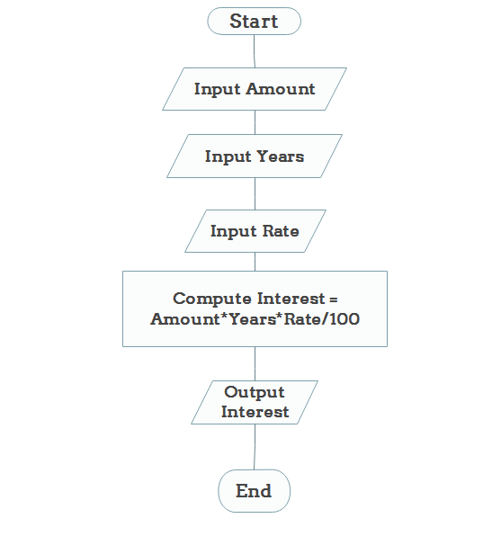
Example- Draw the flow chart of simple interest.
*
22

Slide 23
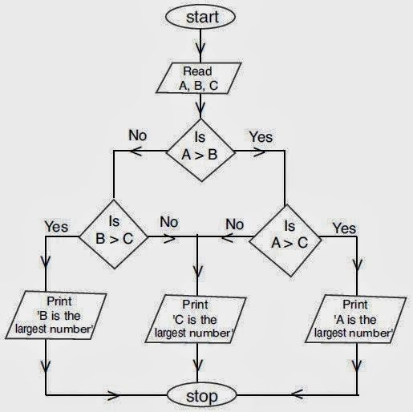
Example- Draw the flow chart of largest of three numbers.
*
23

Slide 24
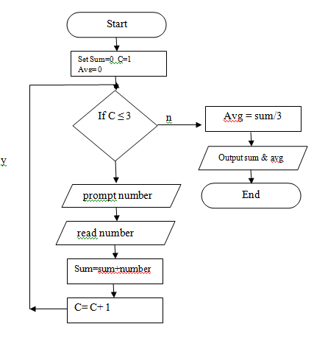
Example- Draw the flow chart of average of N numbers. Note: replace 3 with any number.
*
24

Slide 25
PSEUDO CODE
Definition: Pseudocode is an informal way of programming description that does not require any strict programming language syntax or underlying technology considerations. It is used for creating an outline or a rough draft of a program. Pseudocode summarizes a program’s flow, but excludes underlying details. System designers write pseudocode to ensure that programmers understand a software project's requirements and align code accordingly.
Advantages of pseudo code: • Pseudocode is understood by the programmers of all types. • It enables the programmer to concentrate only on the algorithm part of the code development. • It cannot be compiled into an executable program.
*
25

Slide 26
PSEUDO CODE CONTINUE…
Example: Average of 10 numbers
Set total = 0
Set I =1
While i is less than or equal to 10
Input the next number
Add the number into the total
I = I +1
Set the average to the total divided by 10
Print the average.
*
26

Slide 27
STRUCTURED/PROCEDURAL PROGRAMMING
Structured programming techniques use functions or subroutines to organize the programming code. The programming purpose is to break the large code into smaller pieces and organized together using function.
This technique uses the concept of modularization/top down design approach to provide cleaner code and simplifies maintaining the program. Each function has its own identity and isolated from other, thus change in one function doesn’t affect other.
Features of Structured Programming
Codes are simple to write & understand
Concise & clear codes, easy to debug
Effective & Efficient code Execution
Scalability & reusability of functions
*
27

